Slide 1
Detecting Chess Captures with CNNs
Luka Trikha | DMC435

Slide 2
What was the Original Idea?

Slide 3
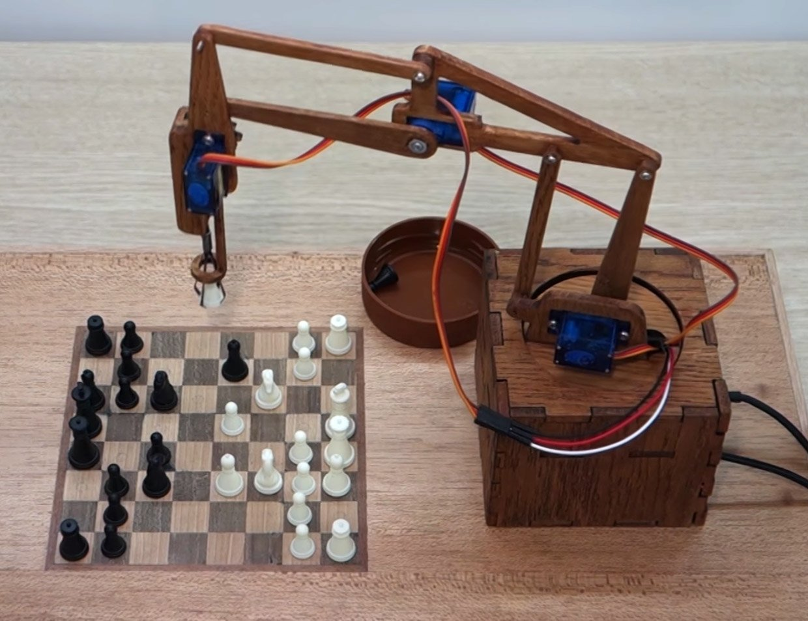
Create Two Chess Bots with Two Different Models to Compete with One Another

Slide 4
Create Two Chess Bots with Two Different Models to Compete with One Another
Deep Reinforcement Learning Agent:
Learn from a chess environment.
Would not need to learn the rules, since rules are contained in the environment.
Would learn from previously recorded full games.

Slide 5
Create Two Chess Bots with Two Different Models to Compete with One Another
Deep Reinforcement Learning Agent:
Learn from a chess environment.
Would not need to learn the rules, since rules are contained in the environment.
Would learn from previously recorded full games.
CNN Move Selector:
Identify which piece is in most danger.
Select that piece to move.
Identify where is the best potential spot to go to.

Slide 6
Why I Didn’t Do that?

Slide 7
Way Too Hard
Training two separate models is time consuming.
Both on me and computer.
Too many hyperparameters to think about.
A lot of ML theory in both models that we have not discussed.
Using non-traditional approaches to CNN.
Different types of RL.

Slide 8
Next Idea: Only Focus on CNN Model to Predict Most-Endangered Piece and Move it

Slide 9
Outcome:

Slide 10
Did not Do It
Turns out, analyzing endangered chess piece was extremely complicated for a CNN to accomplish.
Finding the best-outcome piece was also difficult (but manageable) to do with a CNN.
All in all, it was super hard.
This idea was based off of a research paper by Stanford University.
I am just a junior at Goucher College.

Slide 11
What did I do?

Slide 12
Determine which Player Piece was Endangered Using a CNN

Slide 13
The Data
There were no datasets available on just a list of random chess position that I could sample from.
I did, however, find one dataset that had images of randomly generated chess positions for a completely different project.
I decided to download that, as the titles of all the images were written in FEN notation–that is what I needed.

Slide 14
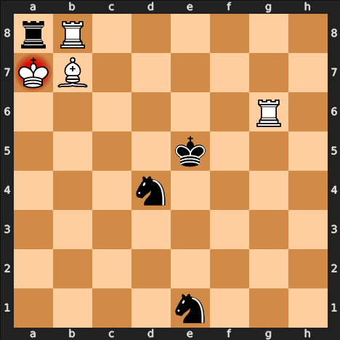
The Data (cont.)
FEN notation is chess game-state expression that can represent any chess board configuration at any given time.
Example: rR6/KB6/6R1/4k3/3n4/8/8/4n3

Slide 15
The Data (cont.)
The issue with the data was there was 100,000 .jpeg images, and I only needed the titles of the images…
Had to parse through the entire file, just obtaining the file names and concatenating to text file.
Next issue is that the text file was in the format:
rR6-KB6-6R1-4k3-3n4-8-8-4n3.jpeg
Instead of:
rR6/KB6/6R1/4k3/3n4/8/8/4n3

Slide 16
Two Models Used
Simple 3-Layer CNN with 1 Dense output:
Leaky ReLU on all CNNs.
Padding is same.
Kernel size is 4 on all CNNs.
Filters go from 128, 128, 32.
Dense layer is a 6-neuron output with a softmax activation function.

Slide 17
Two Models Used
Simple 3-Layer CNN with 1 Dense output:
Leaky ReLU on all CNNs.
Padding is same.
Kernel size is 4 on all CNNs.
Filters go from 128, 128, 32.
Dense layer is a 6-neuron output with a softmax activation function.
Makeshift AlexNet Model:
Five CNNs with varying hyperparameters.
Pooling with varying filter sizes.
Dropout of 40%.
Batch Normalization.
Three Dense Layers, two with ReLU activations, and the final one with a softmax.

Slide 18
What is AlexNet?
TLDR: Depth and complex model seemed to prove valuable with accuracy at the cost of being extremely computationally taxing.

Slide 19
Outcomes:
Simple Model:
Accuracy = 39.37%
Loss = 40.32%
Overfitted with validation.
Stopped because of early stopping while monitoring Validation Loss
AlexNet:
Accuracy = 16.29%
Loss = 52.90%
No overfitting or underfitting.
Stopped because of early stopping while monitoring Validation Loss

Slide 20
It did what was Expected
Identifying chess positions with a CNN is hard.
Not giving any heuristics, it was really learning blindly.
Is possible, however extremely challenging. It has been done before.

Slide 21
Credits:
Kaggle Dataset
AlexNet Information
Github
Stanford Research
Chess API

